Slide 1
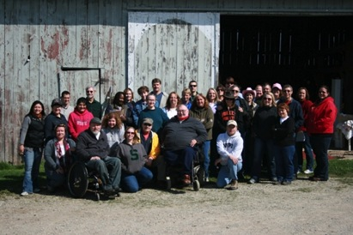
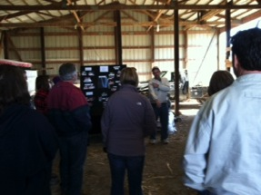
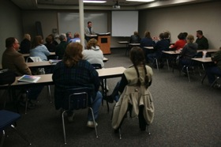
NIDRR-funded
AATT Project (Agricultural Assistive Technology Training)
DOE/OSERS Project # H133G100195
TRAINING OVERVIEW
On-line and In-person Evaluations

Slide 2
AATT Project Purpose & Goals
Purpose
  Create national training program
    Share expertise of five agencies
    Strengthen competencies of Vocational Rehabilitation (VR) counselors with an underserved population
  Goals
    Increase capacity of VR counselors to provide rehabilitation & assistive technology services
    Successful employment outcomes for farmers with disabilities

Slide 3



Overview of AATT Project
Three-Year Project 2010 - 2013
  Improve employment outcomes for farmers with disabilities by using knowledge gained from extensive field research
Collaboration of Five Partners:
Wisconsin
  Technical Assistance and Continuing Education (TACE) Center, Region V

Slide 4
Overview of AATT Project
Objectives
  Create materials & conduct In-person Training (five states – 150 VR staff)
  Develop Online Course (100 VR staff nationwide)
  Measure & share results with NIDRR, AgrAbility and other USDA-funded health programs
  Make online training available to VR professionals upon conclusion of project

Slide 5
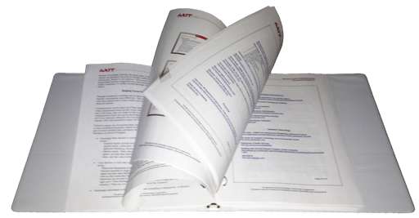
Manual Contents
• About the Agricultural Assistive Technology Training (AATT) Project
• Trainers
• Farm Culture
o Farm Culture PPT
• Farm Culture Resources
o The Culture of Farmers
o Sense of Community
o Understanding the Motivations of Farmers
o It’s Not All Peaceful in the Country
o Life Events Scale and Key
o Case Study
o Farm Culture References
• Implementation Recommendations
o Implementation Recommendations PPT
• Implementation Recommendations
Resources
o Farm Toolkit-Wisconsin DVR
o Case Study
o Implementation Recommendations References
• Farm Viability
o Farm Viability PPT
• Farm Viability Resources
o Schedule F-Farm Tax Form
o Utilization of Recommended Assistive
Technology on Wisconsin Farms
o Farm Viability References
• Agriculture in Your State
o AgrAbility PPT
• Agriculture in Your State
Resources
o Activity Map
• Application of Rehabilitation
Technology
o Application of Rehab Technology PPT
• Application of Rehabilitation
Technology Resources
o Decision Hierarchy-Breaking New Ground
o Case Study 1
o Case Study 2
o Application of Rehabilitation Technology
References

Slide 6
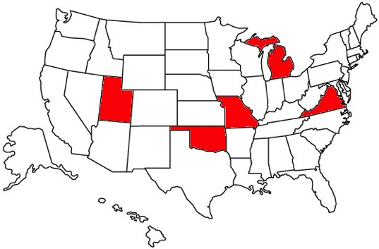
In-person Training
Five states with 149 total participants
  Michigan
  Missouri
  Utah
  Virginia
  Oklahoma
Thank you for making this training a success!

Slide 7
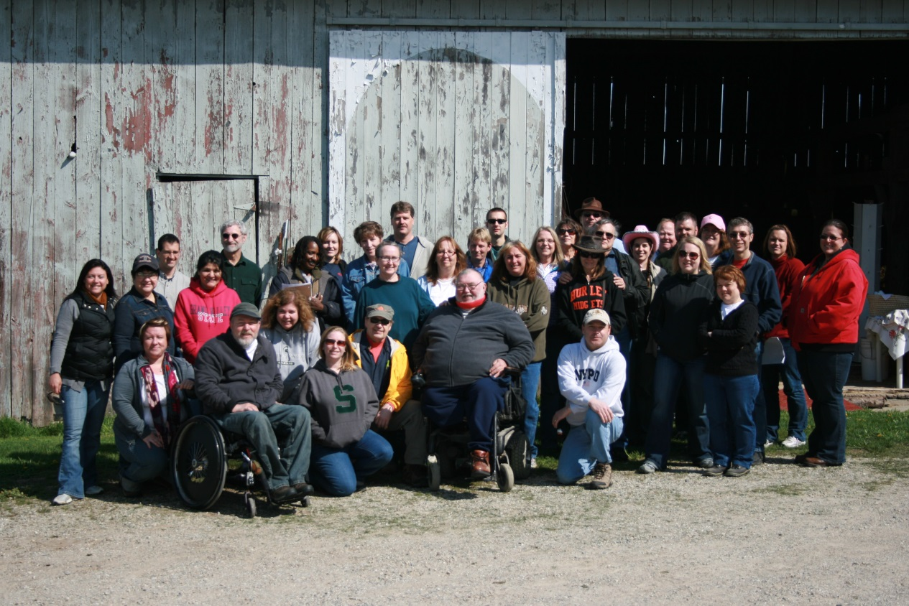
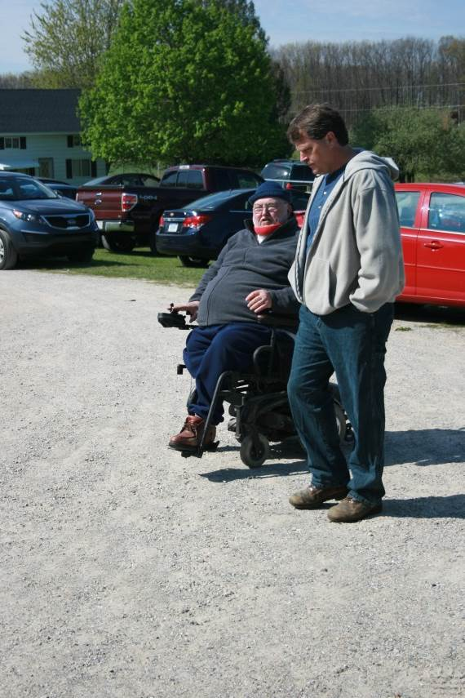
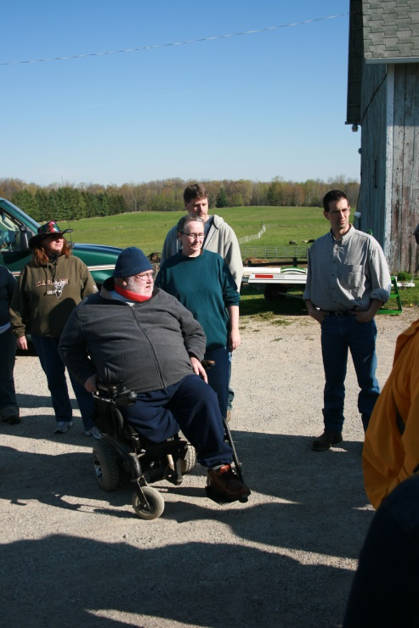
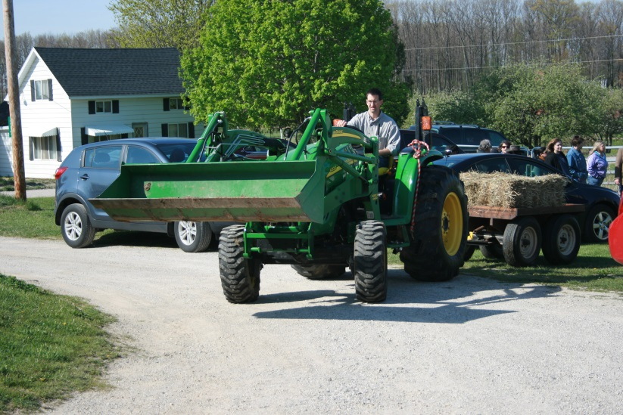
Michigan

Slide 8
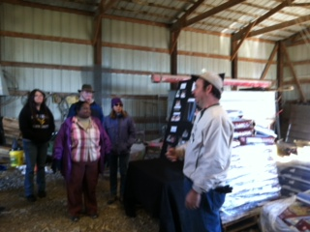
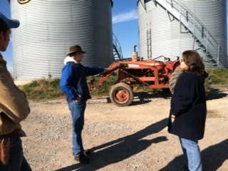
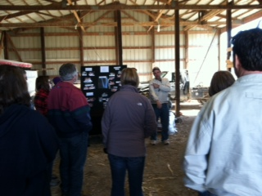
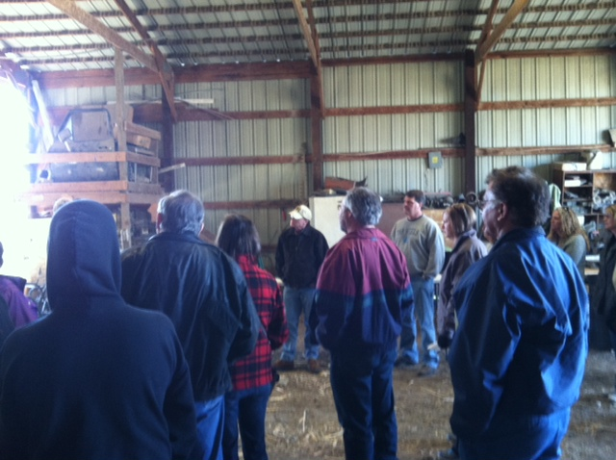
Missouri

Slide 9
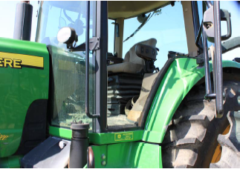
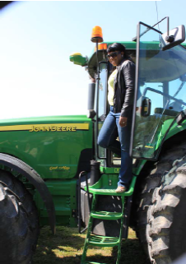
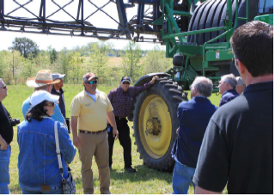
Virginia

Slide 10
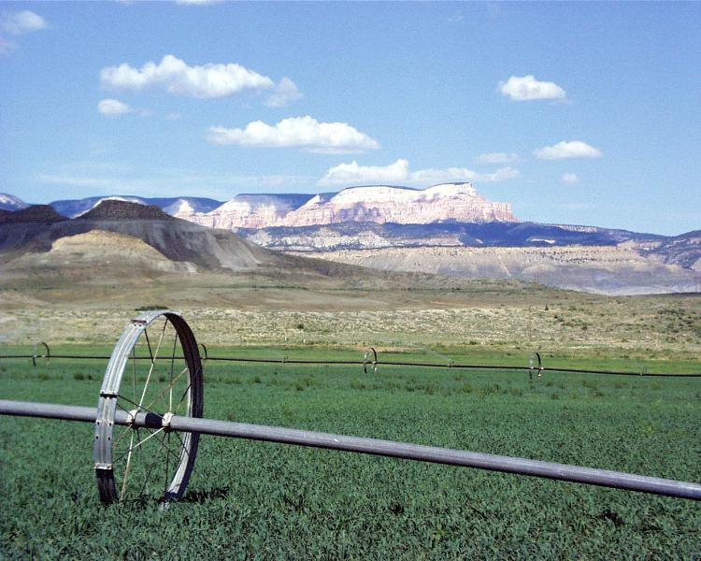
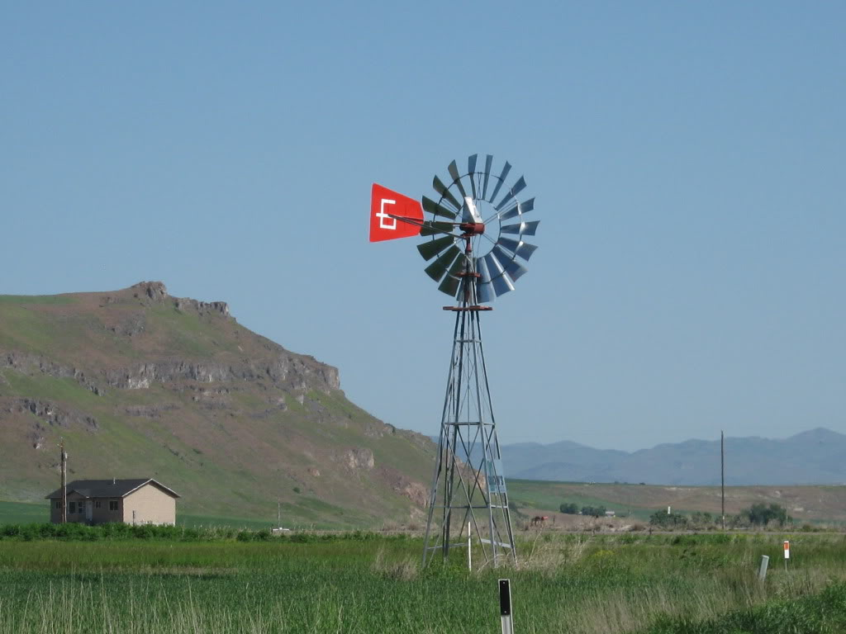
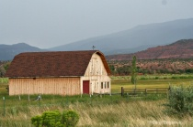
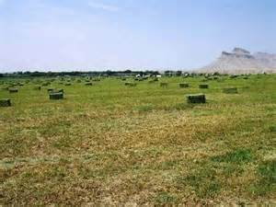
Utah

Slide 11
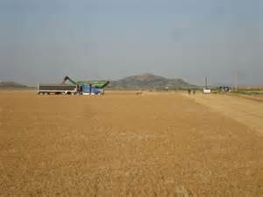
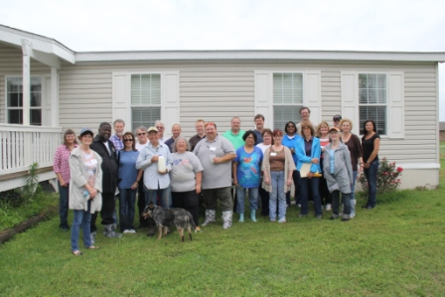
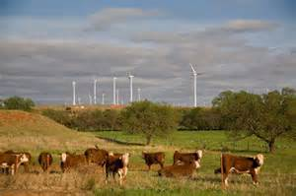
Oklahoma

Slide 12
In-Person Evaluations
* Evaluation summary based on average responses from five training workshops, 149 respondents
** Fifty percent of the participants at the in-person training responded to the six month evaluation

Slide 13
Outcomes of service delivery
(In-person training)
Participants reported serving average of 2.44 farmers 12 months prior to AATT in-person training
Six month post-training survey indicated participants serving average of 4.33 farmers
77% increase in farmers served

Slide 14
Comments
“The understanding of the farm culture was great. It was helpful to visit the farm and learn about the equipment needed for farming.”
“The farm visits bring it home, to see the physical difference made is eye opening.”
“Seeing examples of accommodations helps me to look at a person’s limitations and need for accommodations rather than focus on retraining.”

Slide 15
Comments
“Excellent training. It was very helpful to go to an actual farm and see the equipment as well as meet the farmers.”
“Great training! Really like the training materials, presentations, interaction and farm visit. Felt uncomfortable with the population (farmers) but now feel more comfortable.”

Slide 16

Online Training
Five Online Course sessions offered Sept 2012– July 2013
  101 participants completed course
  89% of those participants completed survey
    Summary of the evaluation results are based on average responses from all five online training course sessions

Slide 17
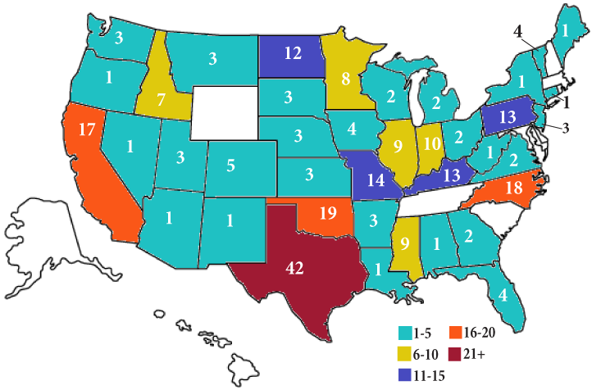
Online Participants by State

Slide 18
Online Evaluations
*Sixty eight percent of participants who completed the online course completed the six month follow-up evaluation

Slide 19
Outcomes of service delivery
(Online training course)
Participants reported serving average of 1.53 farmers 12 months prior to AATT online training course
Six month post-training survey indicated participants serving average of 2.22 farmers
45% increase in farmers served

Slide 20
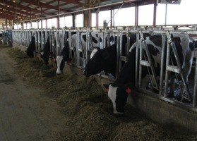
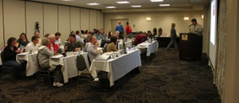
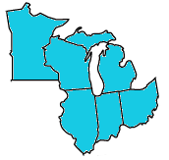
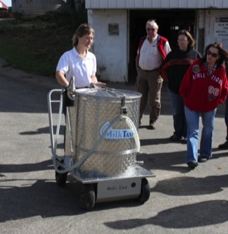
Training Assistance and
Continuing Education (TACE)
32 participants, TACE Training District 5, from
  Minnesota
  Wisconsin
  Michigan
  Ohio
  Illinois
  Indiana

Slide 21
Lessons Learned
All VR Programs had a desire to increase services to farmers with disabilities
All VR Programs expressed concern and frustration about understanding how to connect with this population
System barriers we identified were not developed intentionally to limit services to farmers

Slide 22
Barriers
Lack of cultural understanding of farmers
Farmers not applying for services ( do they know the VR Program can help them?)
System
  Application
  State Purchasing process
  Determining income

Slide 23
Opportunities for Collaboration
Outreach
Cultural understanding
Service process review
AgrAbility Projects gaining a deeper understanding of the VR Program in general

Slide 24
New NIDRR application
New NIDRR grant application
Submitted February 2014
Three years
Six In-person trainings (2 per year)
Six online courses (2 per year)

Slide 25
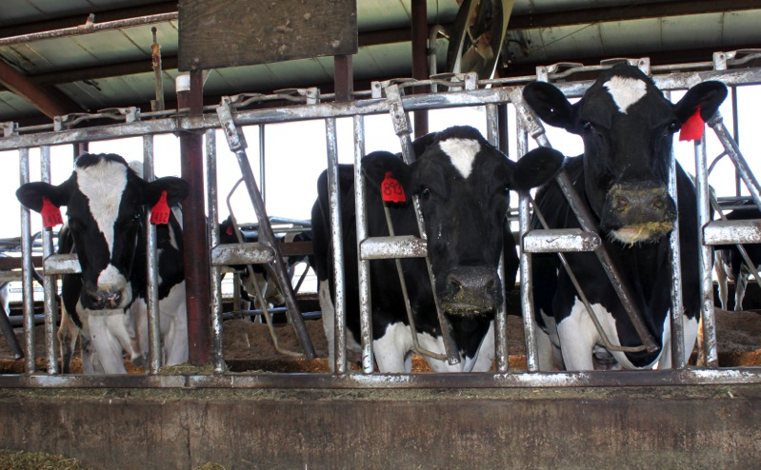
Any Questions?

